Slide 1



Record a Presentationv
Use the Camtasia Add-in to record your presentations. Start by going to the Add-ins tab.
T20_Matches Analysis

Slide 2




Camtasia Recording Toolbar
About
The dataset contains detailed information about T20 cricket matches, including teams, venues, scores, and match results.
It helps analyze team performance, win/loss trends, and match outcomes over different matches or seasons.
The dashboard presents key insights using charts, KPIs, and filters for easy understanding.
Interactive visuals allow users to compare teams, venues, and match statistics quickly.
Overall, the dashboard supports data-driven insights to understand patterns and performance in T20 cricket.
Begin
recording
Toggle camera
recording
Adjust specific
recording options
Toggle microphone
recording
Display camera
preview

Slide 3
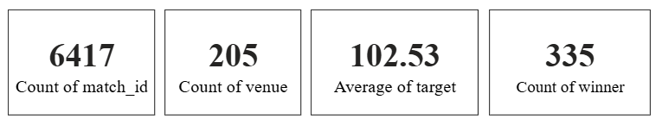
Cards - T20 Cricket: Key Match Statistics Overview
The dashboard includes data for a total of 6,417 T20 matches.
Matches were played across 205 different venues, showing wide geographical coverage.
The average target score across matches is around 102.53 runs.
There are 335 different winners/results, indicating strong competition among teams.
These summary cards give a quick overall view of the T20 match dataset at a glance.

Slide 4
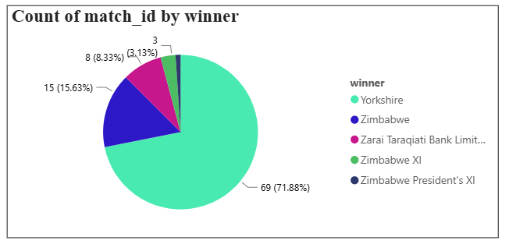
Pie Chart – Team-wise Match Wins Overview
This visual is used to compare the number of matches won by each team clearly.
Yorkshire dominates with about 72% (69 wins), showing a strong overall performance.
Zimbabwe follows with 15 wins (16%), while other teams have much smaller shares.
The pie chart helps quickly identify the most successful and least successful teams at a glance.

Slide 5
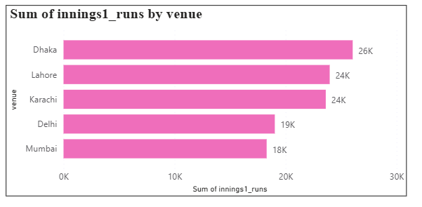
Bar Chart – Sum of Innings 1 Runs by Venue
This visual shows the total runs scored in the first innings at each venue.
Dhaka has the highest total with around 26K runs, indicating high-scoring matches.
Lahore and Karachi follow closely, each with about 24K runs.
The bar chart is used to compare scoring patterns across venues easily and identify high-scoring grounds.

Slide 6
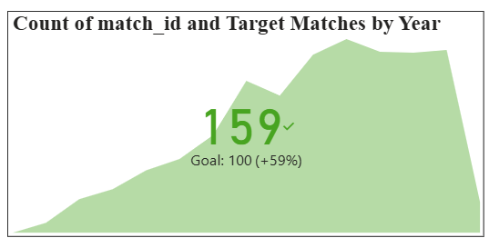
KPI – Matches Played vs Target Over the Years
This visual shows the total number of matches played over the years.
It compares the actual match count with a target of 100 matches.
The current value is 159 matches, which is 59% above the target.
It helps quickly evaluate performance and track overall growth.

Slide 7
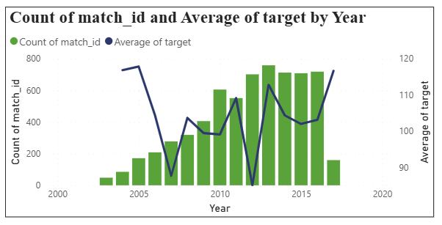
.
Line and Stacked Column Chart – Year-wise Matches and Average Target
The green bars represent the number of matches played each year, which generally increases over time.
The blue line shows the average target score per year, which goes up and down across seasons.
This visual helps understand the relationship between match volume and scoring difficulty over the years.

Slide 8
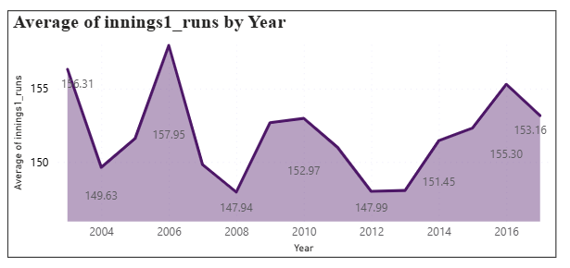
Area Chart – Average of Innings 1 Runs by Year
This visual represents the year-wise average runs scored in the first innings.
The average score rises and falls over the years, showing changes in match conditions and playing style.
Higher averages around 2006 and 2016 indicate more high-scoring matches in those years.
The line chart is used to clearly track performance trends and compare yearly averages.

Slide 9
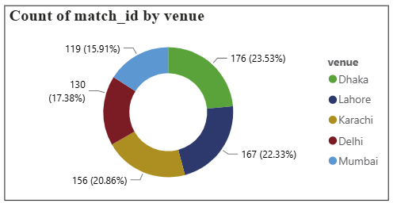
.
Donut Chart – Matches Played at Each Venue
This visual shows the number of matches played at each venue.
Dhaka has hosted the most matches, followed closely by Lahore.
Karachi and Delhi have a moderate share of matches, while Mumbai has the least.
The donut chart helps quickly compare match distribution across venues at a glance.

Slide 10
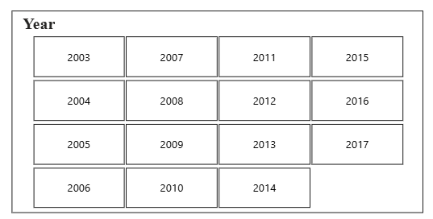
.
.
Slicer – Match Results by Venue and Year
This visual allows users to select specific years from the dataset.
It helps filter all other visuals on the dashboard based on the chosen year(s).
Multiple years can be selected to compare performance across different seasons.
This makes the analysis interactive, focused, and easy to understand.

Slide 11


